Slide 1
Quiz Game Project in C Language
Prepared by: Saham Abdullah CT-25194
Ayan Khan CT-25181
Language: C Programming

Slide 2
Abstract
This project is a console-based quiz game developed in C. The game tests general knowledge with multiple-choice questions and introduces lifeline options (50/50 and Hint). It demonstrates user input handling, control structures, and decision-making in C programming.

Slide 3
Objectives of the Project
• Create an interactive quiz program using C.
• Implement decision-making using switch and if statements.
• Introduce lifeline features for user interactivity.
• Track and display score dynamically.
• Improve logical and problem-solving skills.

Slide 4
Pseudocode
1. Initialize score = 0, lifelines = 2.
2. Ask question and take user input.
3. Ask if user wants to use a lifeline.
4. If lifeline used → provide hint or 50/50.
5. Take answer and check with switch-case or if.
6. If correct → increment score.
7. Repeat for all questions.
8. Display final score.

Slide 5
Initial Steps
• Include header files: stdio.h, stdlib.h.
• Declare variables for score, answer, lifelines.
• Initialize lifelines and score.
• Display first question and options.

Slide 6
Requirements of the Program
Hardware:
• Any system with a C compiler.
Software:
• Turbo C, Code::Blocks, or Dev-C++.
Knowledge:
• Basic C syntax, input/output, conditionals, and functions.

Slide 7
Working of the Program
• Displays four multiple-choice questions.
• Player can use a lifeline (50/50 or Hint).
• Each question checks correctness and updates score.
• Lifelines can be used only once.
• At the end, displays the final score.

Slide 8
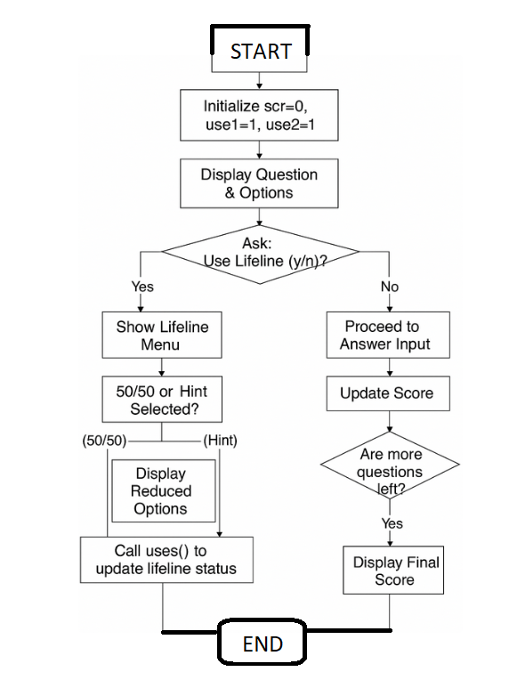
Flowchart

Slide 9
Usage of Loops and Switch Statements
Although loops are not explicitly used, each question follows a structured, repetitive pattern. Decision-making is handled using if-else statements for lifeline use and correctness checks.
Example:
if (c == 'b') {
printf('Correct!');
scr++;
} else {
printf('Wrong!');
}

Slide 10
Control Structures Used
• If-else statements: Handle lifeline use and correctness.
• Sequential structure: For question flow.
• Function usage: 'uses()' displays remaining lifelines.
• No loops — handled sequentially per question.

Slide 11
Possible Errors in the Program
• Input error: Invalid character entered.
• Logical error: Using lifelines repeatedly.
• Compilation errors: Syntax mistakes.
• Runtime errors: None expected with valid input.

Slide 12
Quiz Game in the Past vs. Now
Past:
• Text-based and static quizzes.
• No interactive lifelines.
Present:
• GUI-based quizzes.
• Sound, colors, and animations.
• Online multiplayer features.

Slide 13
Improvements That Can Be Made
• Add loops for dynamic question handling.
• Store and read scores from files.
• Include difficulty levels.
• Add graphical interface and sound effects.

Slide 14
Advantages of the Project
• Enhances understanding of user input handling.
• Demonstrates use of functions and conditional logic.
• Introduces game logic design in C.
• Strengthens programming fundamentals.

Slide 15
Conclusion
The Quiz Game in C demonstrates how control structures, conditional logic, and user interaction can be combined to make engaging programs. The project serves as a foundation for advanced versions featuring loops, databases, and GUI enhancements.

